Slide 1

Synthetic data generation I. Kaloskampis, L. Benedikt, C. Joshi, D. Pugh, S. Hill, A. Noyvirt, L. Nolan
30 May 2018

Slide 2
Project overview
Problems with using real world data
Data sensitivity
Data availability
Missing data
Data labelling for supervised learning algorithms
Solution: Use synthetic data

Slide 3
Research question
Can we use Machine Learning techniques to
Generate synthetic micro data?
Estimate missing values?
Stakeholders
ONS Methodology
ONS Trade team

Slide 4
Impact
Make it easier and faster for ONS to share data with the research communities
A safer way to share sensitive data
Can generalise to similar problems of data sharing and privacy protection in other domains (medical, defence)
Linked to several current ONS Data Science problems (Trade, Housing, etc.)
Set up an online tool for synthetic data generation in the future
Notes:
The ‘so what’ question – what is the value – which should include: value to society / policy imperative, campus learning, collaborator / mentor learning, learning about new data sources, re-use, range of stakeholders etc.

Slide 5
Methodology
What are the techniques we will investigate?
Generative Adversarial Networks (GAN)
Variational Auto-encoder
Auto-regressive models
Others?
Notes:
The ‘so what’ question – what is the value – which should include: value to society / policy imperative, campus learning, collaborator / mentor learning, learning about new data sources, re-use, range of stakeholders etc.

Slide 6
Challenges
What data do we use for proof of concept?
Publicly available datasets (e.g. Police data)
Transfer learning
How to make our methods/models work for different data
Hardware restrictions
Big data problem, deep networks require high performance computers for efficient processing
Privacy issues
Notes:
The ‘so what’ question – what is the value – which should include: value to society / policy imperative, campus learning, collaborator / mentor learning, learning about new data sources, re-use, range of stakeholders etc.

Slide 7
Deliverables
What will you deliver? | How will you know it’s done? | Target date for completion
Literature review methods and data | Written up | End June 2018
Proof of concept basic GAN on small datasets | Model implemented and running | Mid June 2018
Proof of concept other models on small datasets | Model implemented and running
Comparison performances on larger datasets (LFS, Census) | Simulations completed and results written-up
Final report and codes | Conclusions written-up and codes released on Github
Notes:
To include: comms e.g. project profile, blog(s), etc.; capability building e.g. collaborator(s) will be able to use and adapt code; article, code, dataset & tool publication etc. as appropriate
Make sure all outputs (tangible & otherwise are included

Slide 8
Stakeholders
Who? | How are they involved? | How are you communicating?
ONS Methodology | Collaboration, testing, QA-ing | TBD ( Show & Tell)
ONS Trade Team | Collaboration, testing, QA-ing | TBD ( Show & Tell)
ONS Business Areas | Users of the tool | TBD (not before proof of concept ready)
Other government Departments | Users of the tool | TBD (not before proof of concept ready)
Notes:
This should list all of the stakeholders with an interest in the project – include (& specify) ONS teams
How are they involved could be: collaborating, mentoring, customer, share results, notify of publication etc
How are you communicating could be e.g. monthly / weekly meetings, invited to presentation at end of project, email notifying of output etc., invite to show & tell etc or tbd

Slide 9
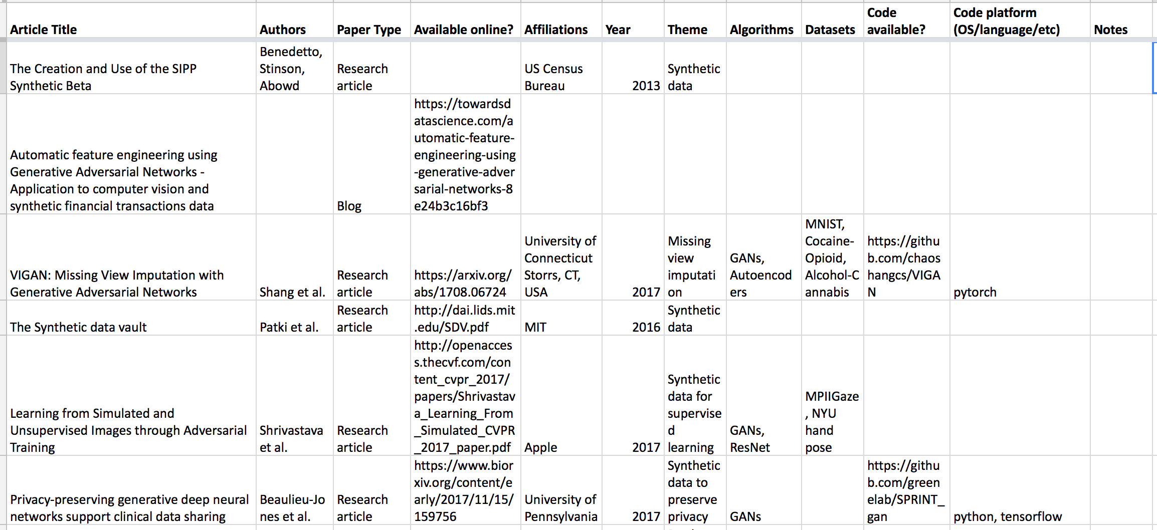
Literature review - Planning and progress
Notes:
Here is where any demos, charts, screen shots, images etc. which show the week’s progress should go
Items should be selected to demonstrate successful task completion – screen shots of work are useful
They do not have to be on the slide, but if they are e.g. demos, videos etc. please provide the links here
You can use more than 1 slide, but please be mindful of the strict time limit, and that this is not a place for detailed QA or technical discussion, and make sure any artefacts here tell your story

Slide 10
Synthetic data demo
Problem: Mimic normally distributed samples starting from a uniform distribution
Synthetic data generator: Generative adversarial network
Implementation: Pytorch
Notes:
Here is where any demos, charts, screen shots, images etc. which show the week’s progress should go
Items should be selected to demonstrate successful task completion – screen shots of work are useful
They do not have to be on the slide, but if they are e.g. demos, videos etc. please provide the links here
You can use more than 1 slide, but please be mindful of the strict time limit, and that this is not a place for detailed QA or technical discussion, and make sure any artefacts here tell your story

Slide 11
GAN diagram
Source: https://www.linkedin.com/pulse/gans-one-hottest-topics-machine-learning-al-gharakhanian?trk=pulse_spock-articles
Notes:
Security environment, access to confidential data, permissions etc.

Slide 12
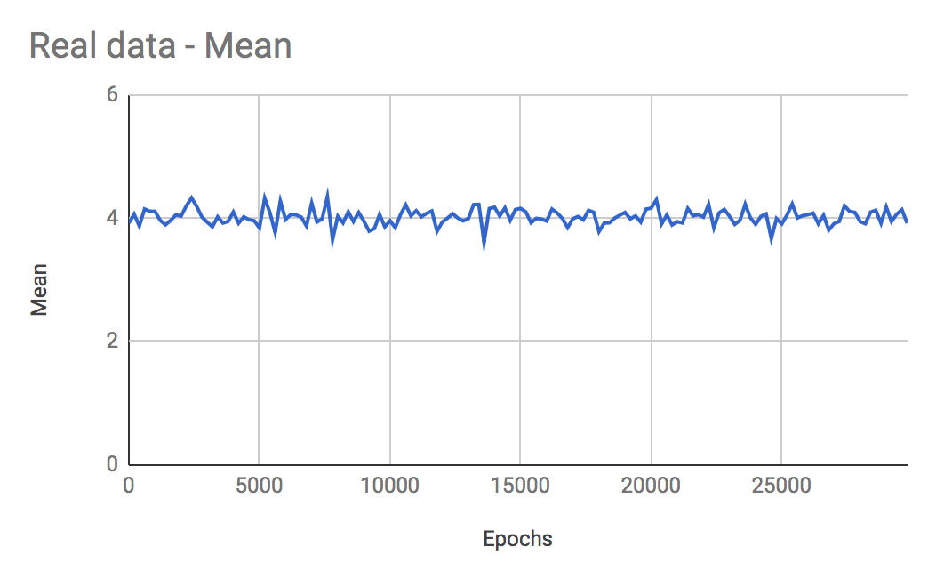
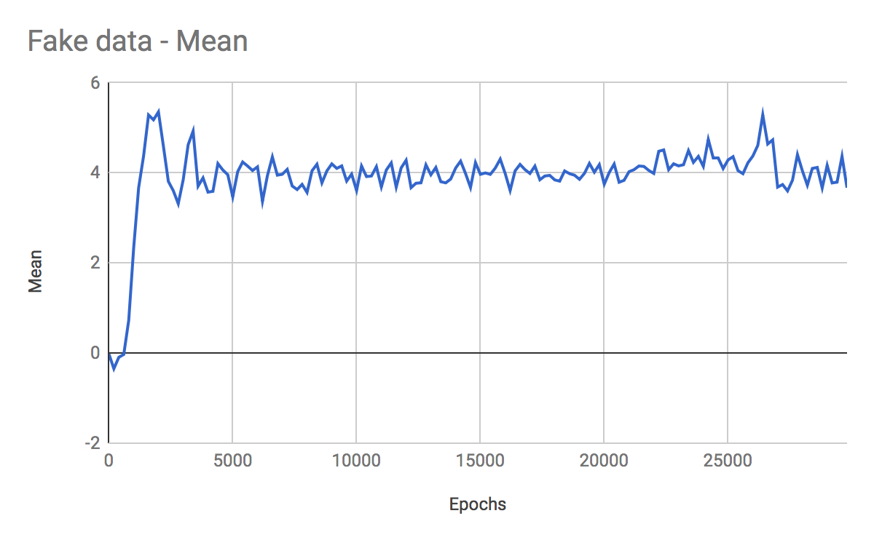
Normal distribution - Mean
Notes:
Here is where any demos, charts, screen shots, images etc. which show the week’s progress should go
Items should be selected to demonstrate successful task completion – screen shots of work are useful
They do not have to be on the slide, but if they are e.g. demos, videos etc. please provide the links here
You can use more than 1 slide, but please be mindful of the strict time limit, and that this is not a place for detailed QA or technical discussion, and make sure any artefacts here tell your story

Slide 13
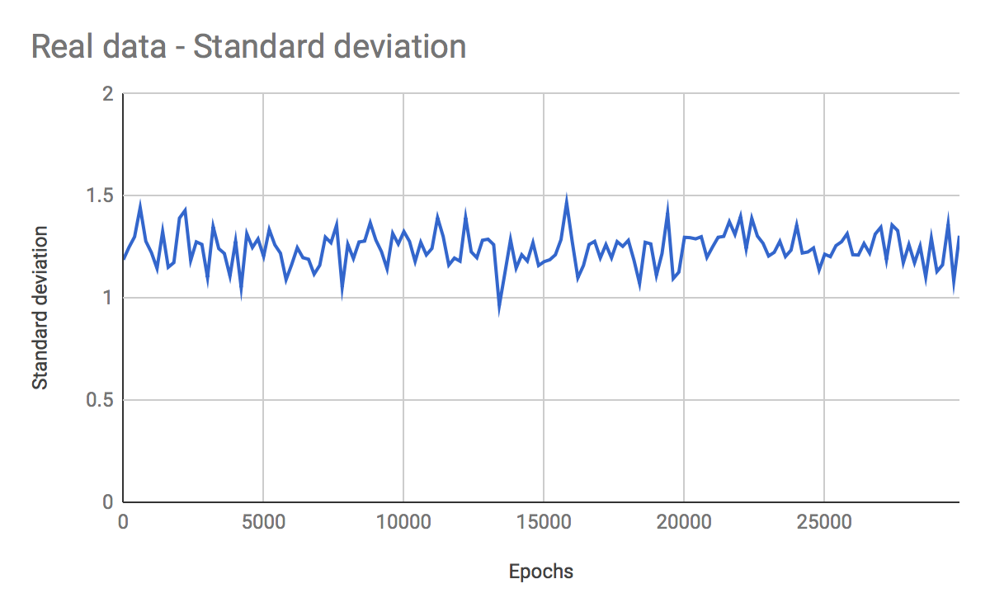
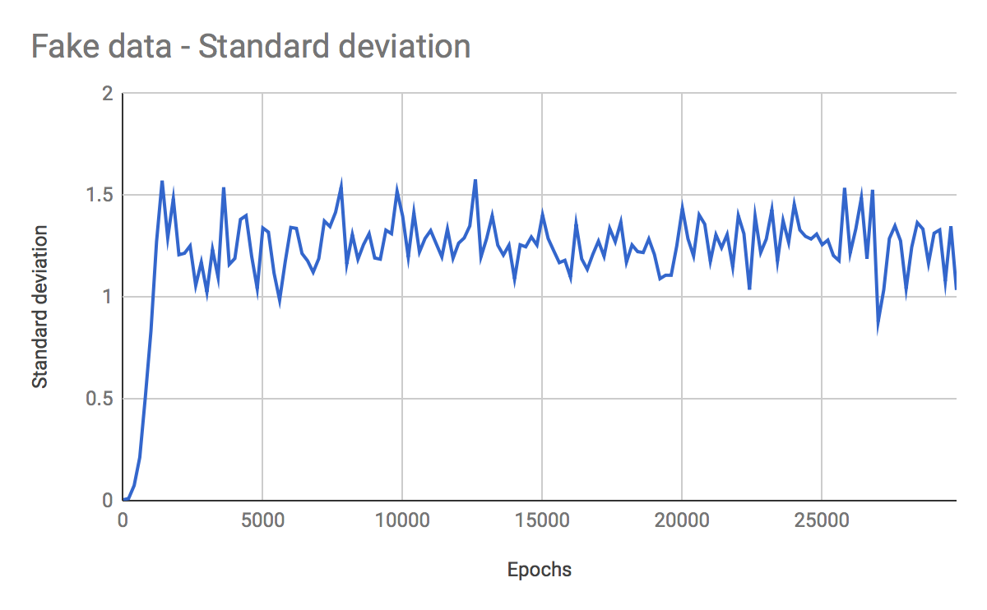
Normal distribution - Standard deviation
Notes:
Here is where any demos, charts, screen shots, images etc. which show the week’s progress should go
Items should be selected to demonstrate successful task completion – screen shots of work are useful
They do not have to be on the slide, but if they are e.g. demos, videos etc. please provide the links here
You can use more than 1 slide, but please be mindful of the strict time limit, and that this is not a place for detailed QA or technical discussion, and make sure any artefacts here tell your story

Slide 14
Project roadmap
Scoping Phase: discussion with stakeholders, clarify objectives, define roadmap – Complete.
Prototype: identify appropriate datasets, investigate methods – In progress
Real data: refine methods, transfer learning
Notes:
Phases:
I. Scoping Phase: discussion with stakeholders, clarify objectives, define roadmap
II. Prototype: identify appropriate datasets, investigate methods
III. Real data: refine methods, transfer learning
Align it with deliverables.

Slide 15
Progress
Literature Review
Main part complete using the Bibliography template
New parts added as we go (e.g. W-GANs, activation functions)
Virtual Machines
Craig has sorted out the Windows VMs
Desktop computer
XQUARTZ, Tensorflow + CUDA + Keras
Sprint planning and develop milestones for roadmap
Notes:
Security environment, access to confidential data, permissions etc.

Slide 16
Progress
Ethical Review Meeting
Low risk – Project may proceed
Prototype: Find suitable datasets
Police data, Census ATLAS, MNIST, Trade
Meet with stakeholders to discuss roadmap
Notes:
Security environment, access to confidential data, permissions etc.

Slide 17
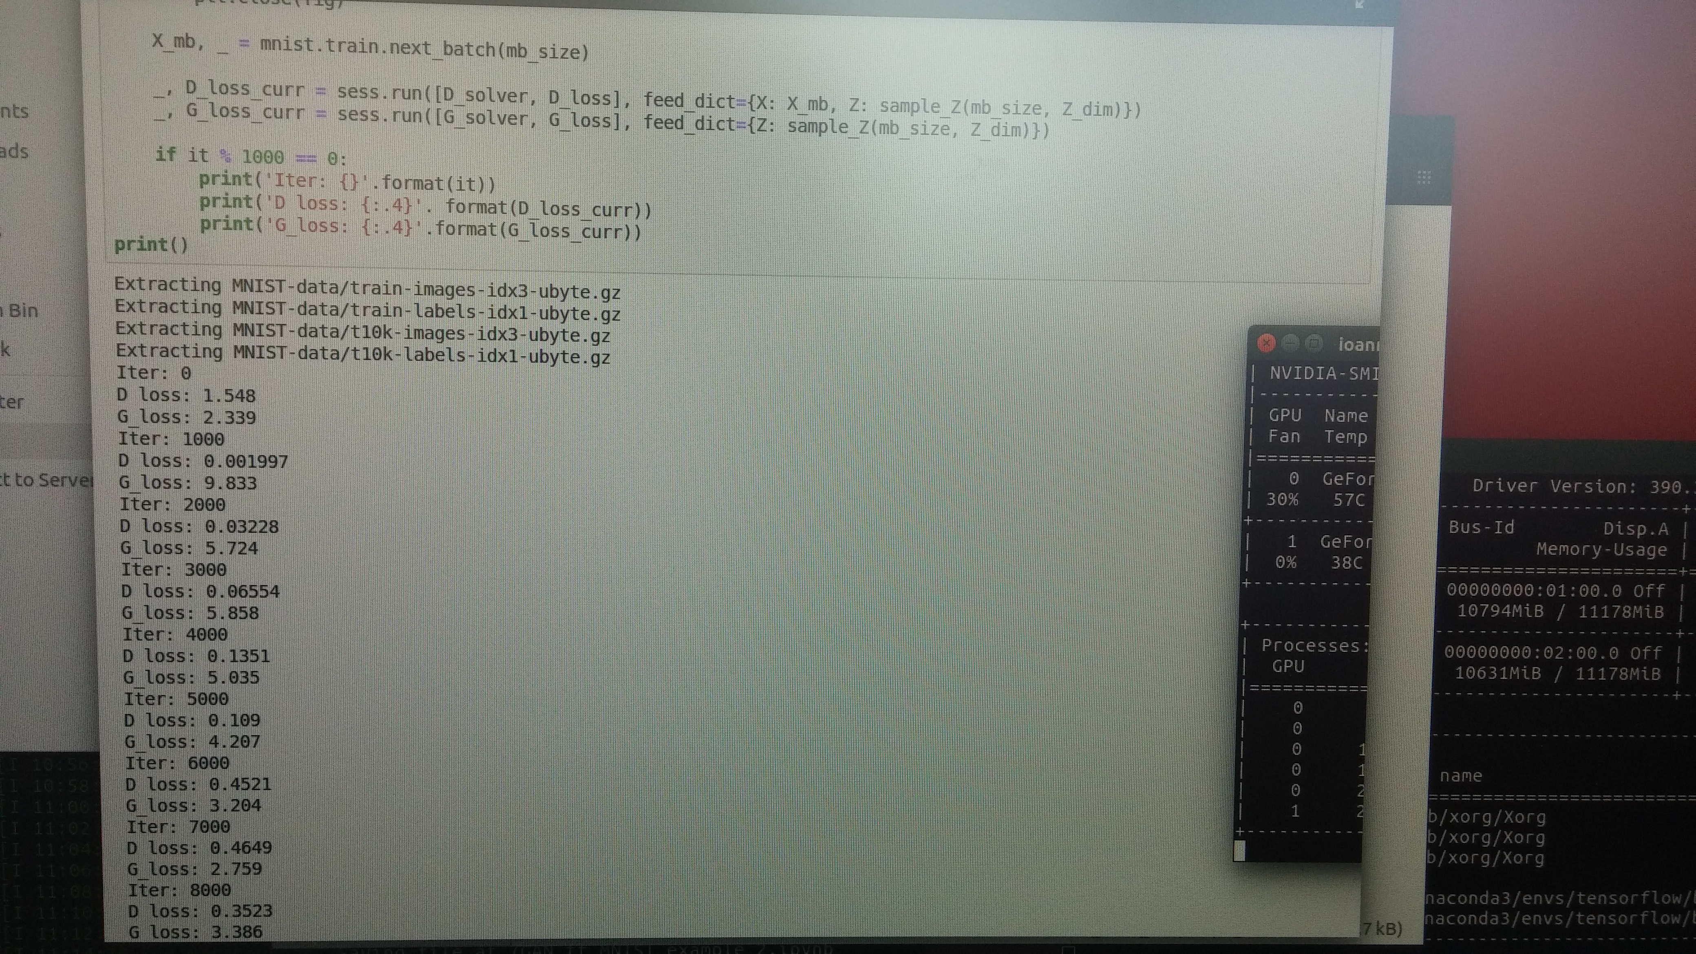
Progress
Notes:
Security environment, access to confidential data, permissions etc.

Slide 18
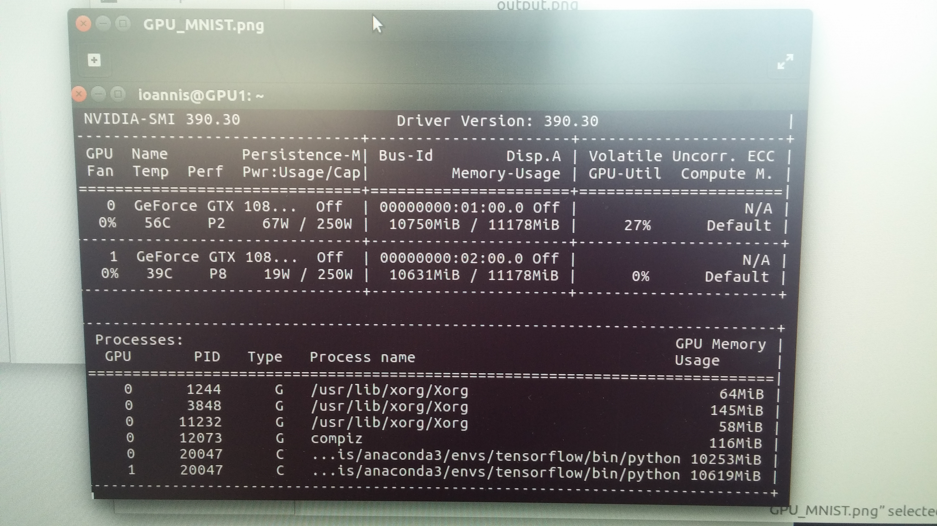
Progress
Notes:
Security environment, access to confidential data, permissions etc.

